Slide 1
Meeting Week 18
Last week summary
Simscape update
Verify LTI gantry implementation without dynamic parallel
Informative data for LTI model
Outline ToDo next week

Slide 2
Last week summary

Slide 3


Slide 4


Slide 5
Results verified against simscape
System with MSD vs Simscape with MSD
RMSE X1 : 2.4919e-07 m
RMSE X2 : 1.6463e-07 m
RMSE Y : 5.0275e-09 m
System without MSD vs Simscape with MSD
RMSE X1 : 4.4957e-07 m
RMSE X2 : 2.9607e-07 m
RMSE Y : 7.6171e-09 m
For ASMPT it was required that the formulas for the additional state are correct

Slide 6
Update: verify augmented model against simscape
Offset was incorrect in simscape model
Previous in range e^-7 both models

Slide 7
Correction simscape model
Offset not properly connected
RMSE of system with MSD vs Simscape with MSD
RMSE X1 : 5.4695e-09 m
RMSE X2 : 4.3447e-09 m
RMSE Y : 8.5888e-10 m
RMSE of system without MSD vs Simscape with MSD
RMSE X1 : 1.9981e-07 m
RMSE X2 : 1.3203e-07 m
RMSE Y : 6.0441e-09 m
Now same error range as original baseline vs original simscape model
Clear difference between baseline and augmented system (MSD)

Slide 8
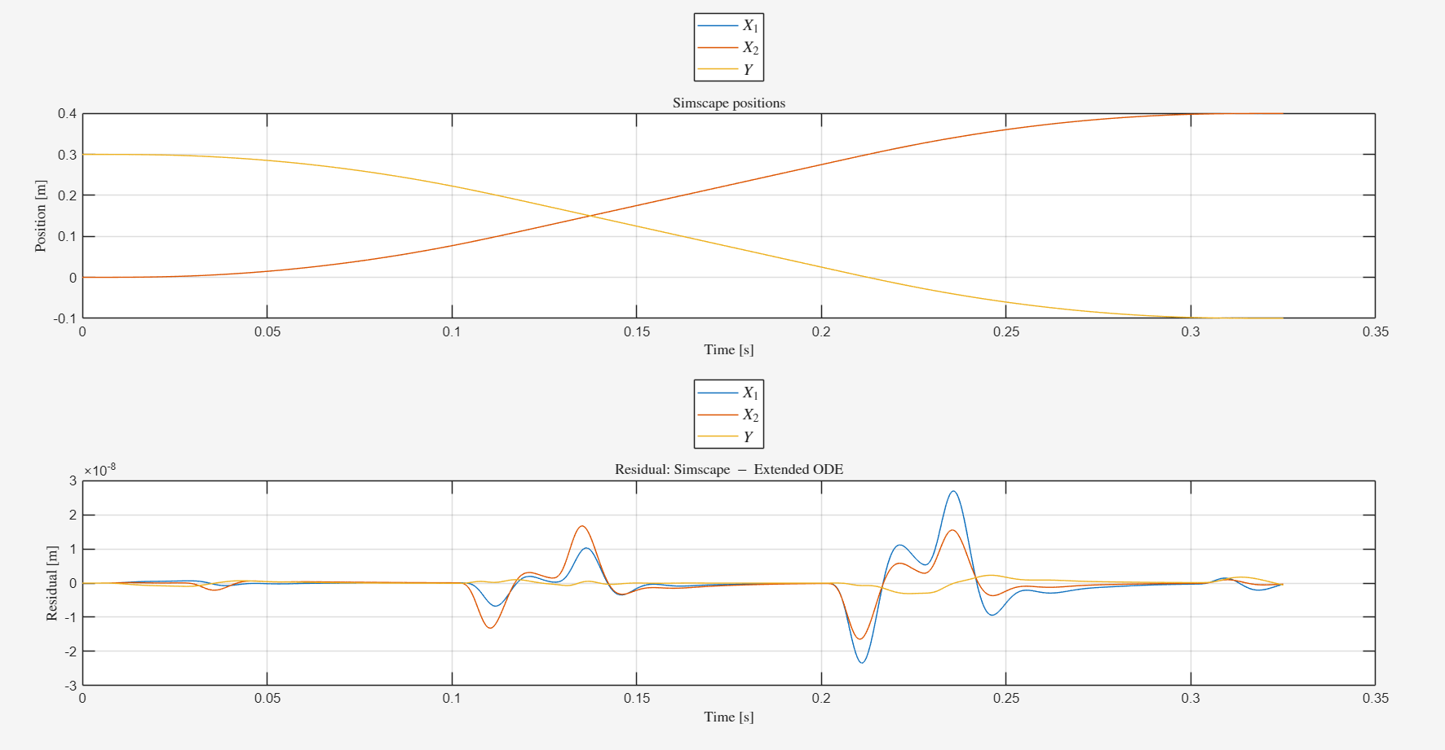

Slide 9
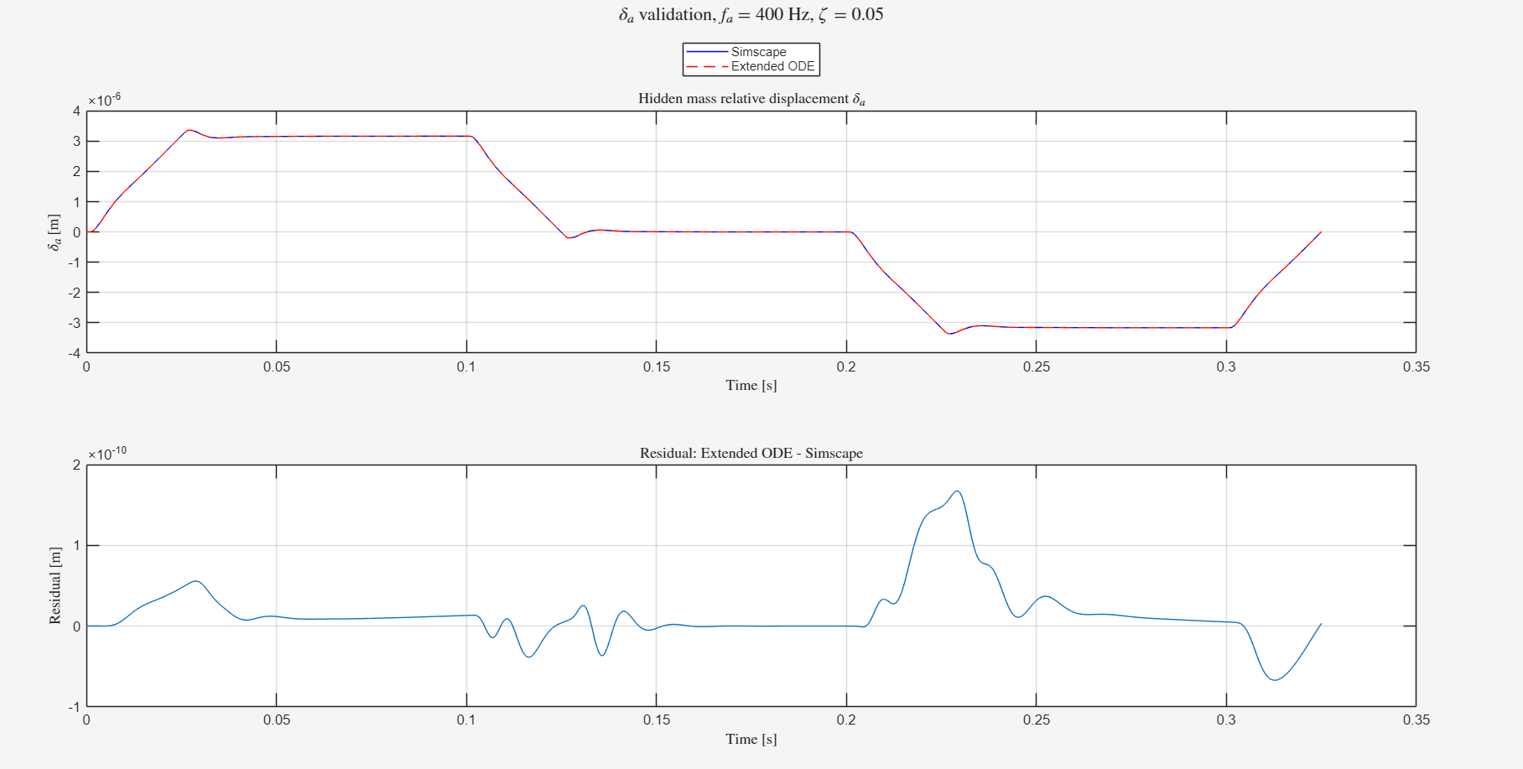

Slide 10
Baseline vs augmented system
Is the added MSD to the payload observable in our data
FRF comparison
  Closed-loop
  Plant

Slide 11
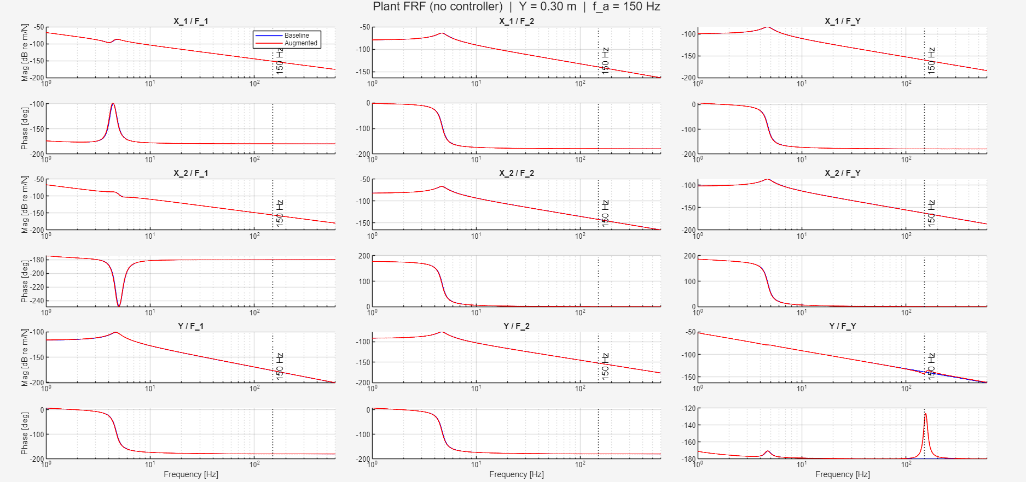

Slide 12
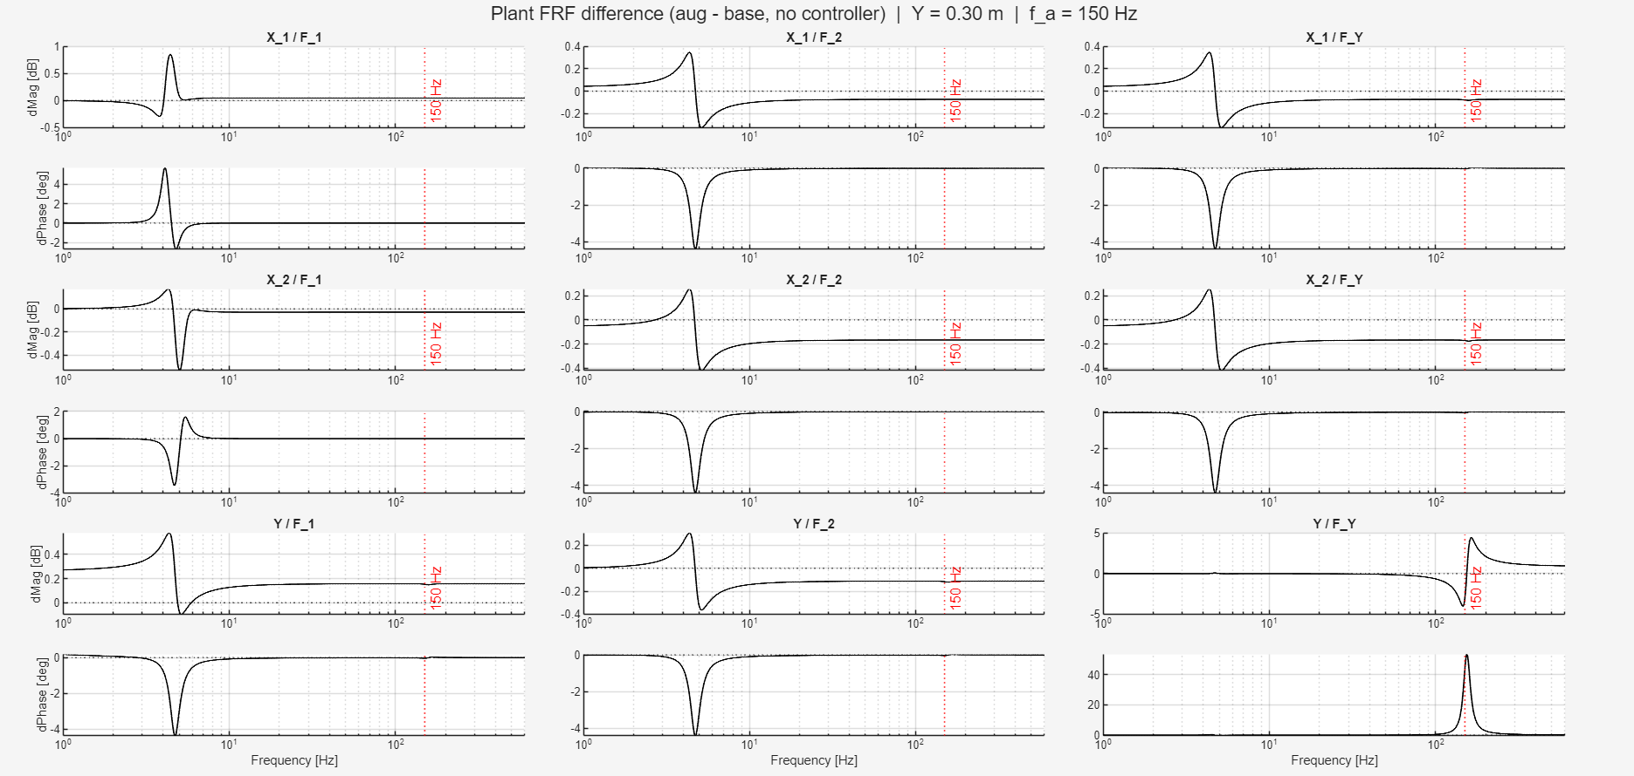

Slide 13
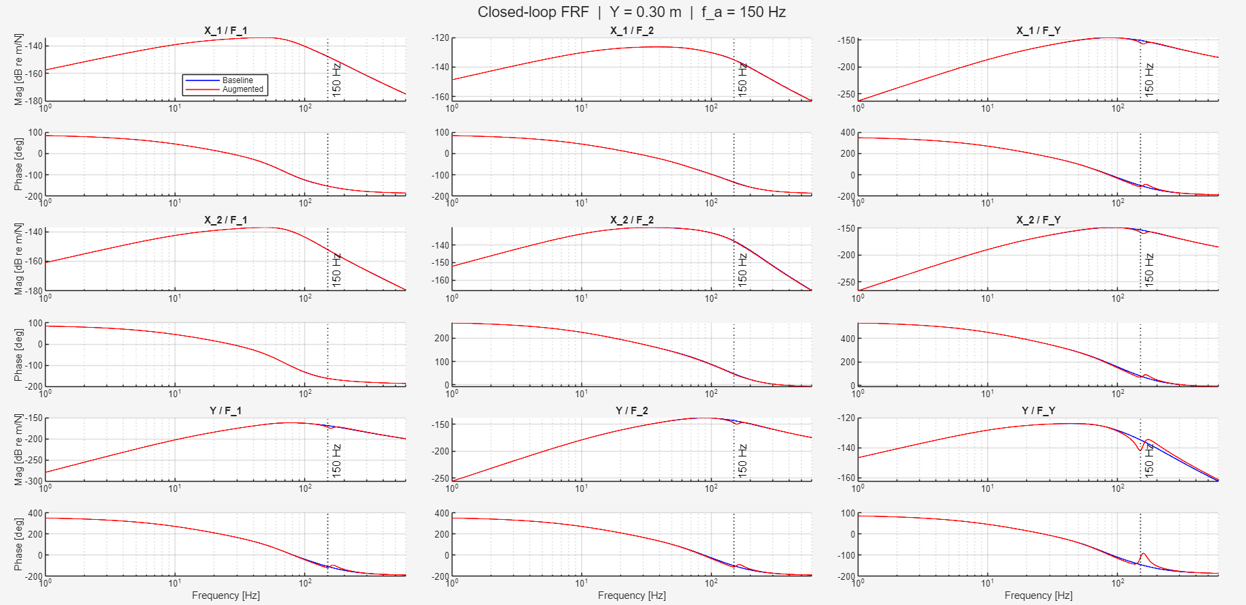

Slide 14
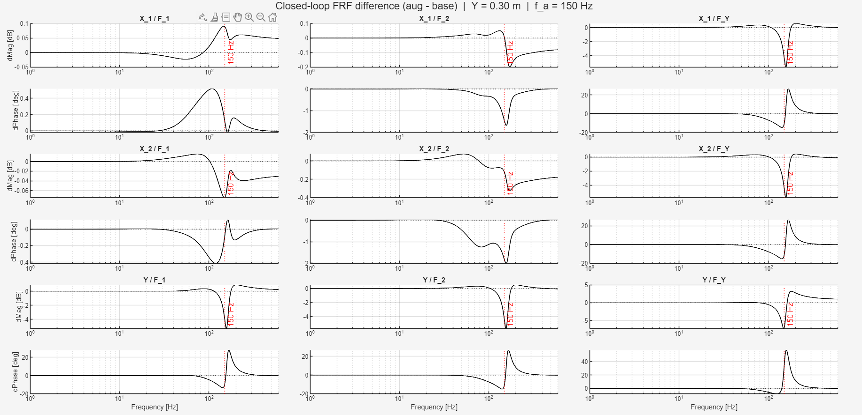

Slide 15
Error between baseline and augmented
Given the same input from closed-loop augmented system to the baseline system.
  What is the difference
Why:
  Want to know whether the baseline model given the input from the augmented system

Slide 16
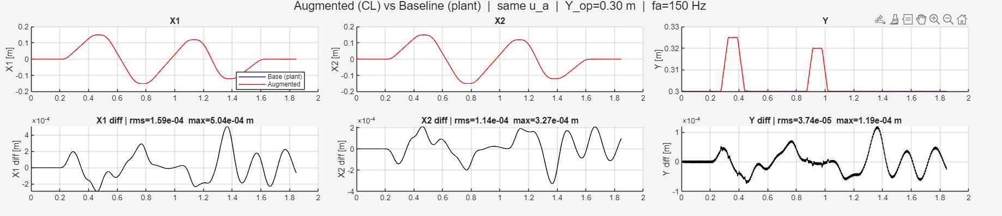
Parameter recovery was able to get in the range e^-7
  With perfect parameters / perfect model is able to get in that range
  We have no noise currently

Slide 17
Verify gantry model implementation
Why:
  Wanted to verify model implementation in code structure
  Also see the effects of LTI against LPV, to justify whether LPV will dominate error or not
    For augmentation to be able to capture additional states
    Only “small” Y-movements because the current model is LTI, need to know if this information is informative
      Compared to data used in parameter recovery (now LTI)

Slide 18
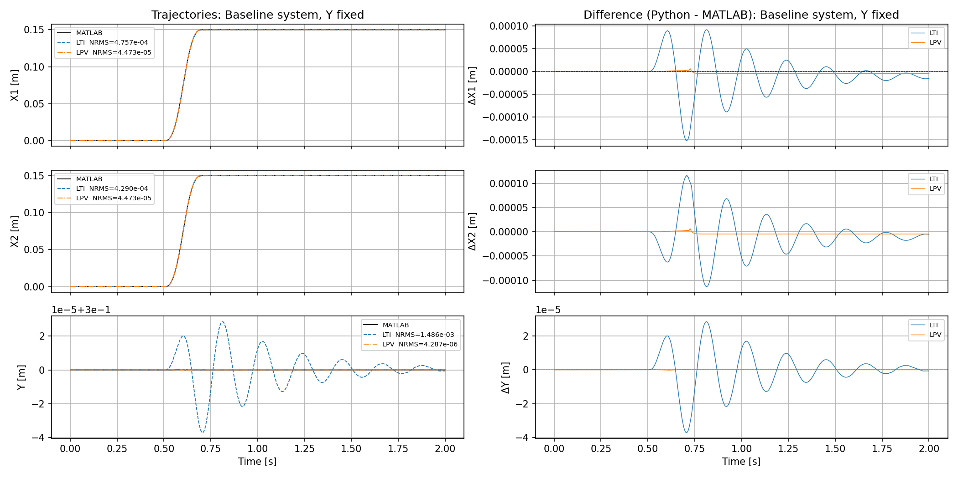
Notes:
1. State normalization — z-score with mean subtraction
x_norm = (x_phys - x_mean) / std_x
2. Input normalization — scaling only, no mean subtraction
u_norm = u / std_u
3. State derivative normalization (inside Gantry_State_Block)
xdot_norm = xdot_phys / std_x

Slide 19
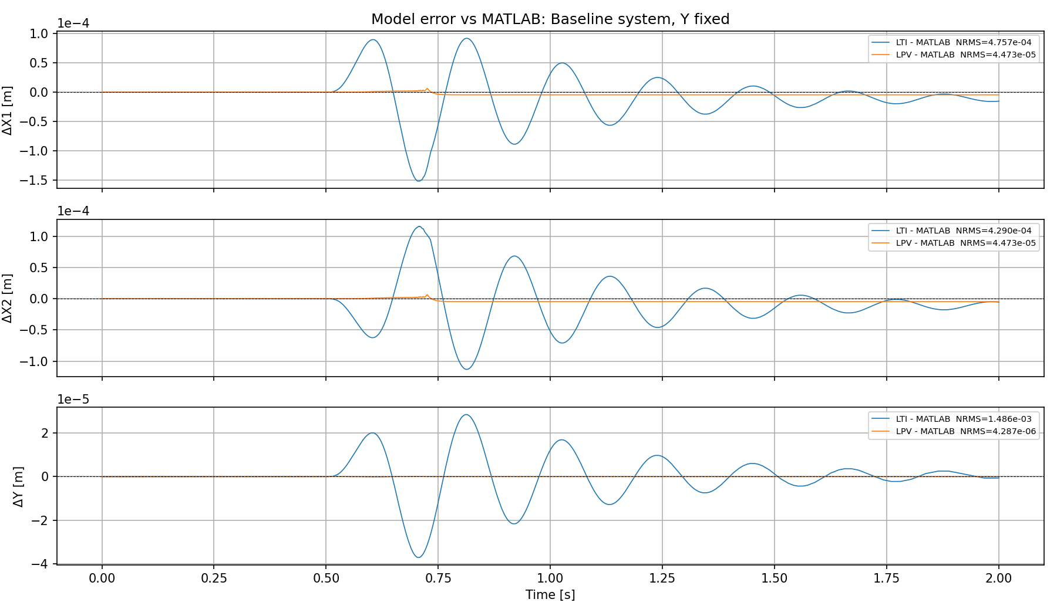

Slide 20
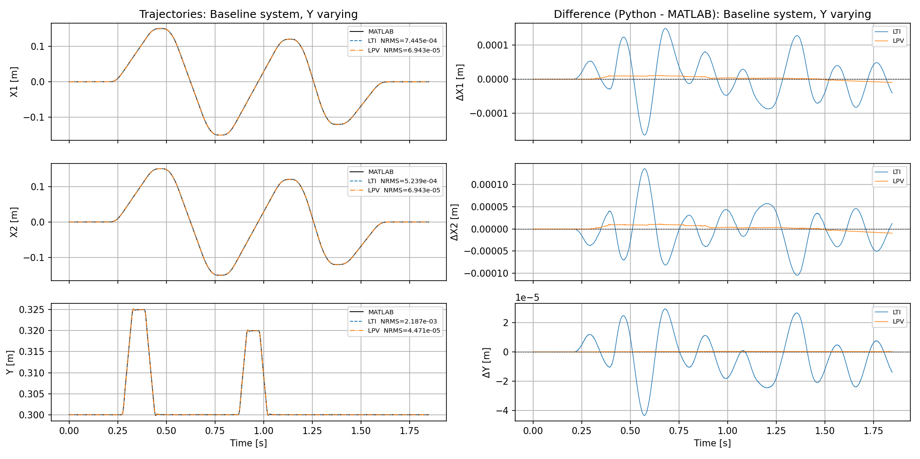
Notes:
1. State normalization — z-score with mean subtraction
x_norm = (x_phys - x_mean) / std_x
2. Input normalization — scaling only, no mean subtraction
u_norm = u / std_u
3. State derivative normalization (inside Gantry_State_Block)
xdot_norm = xdot_phys / std_x

Slide 21
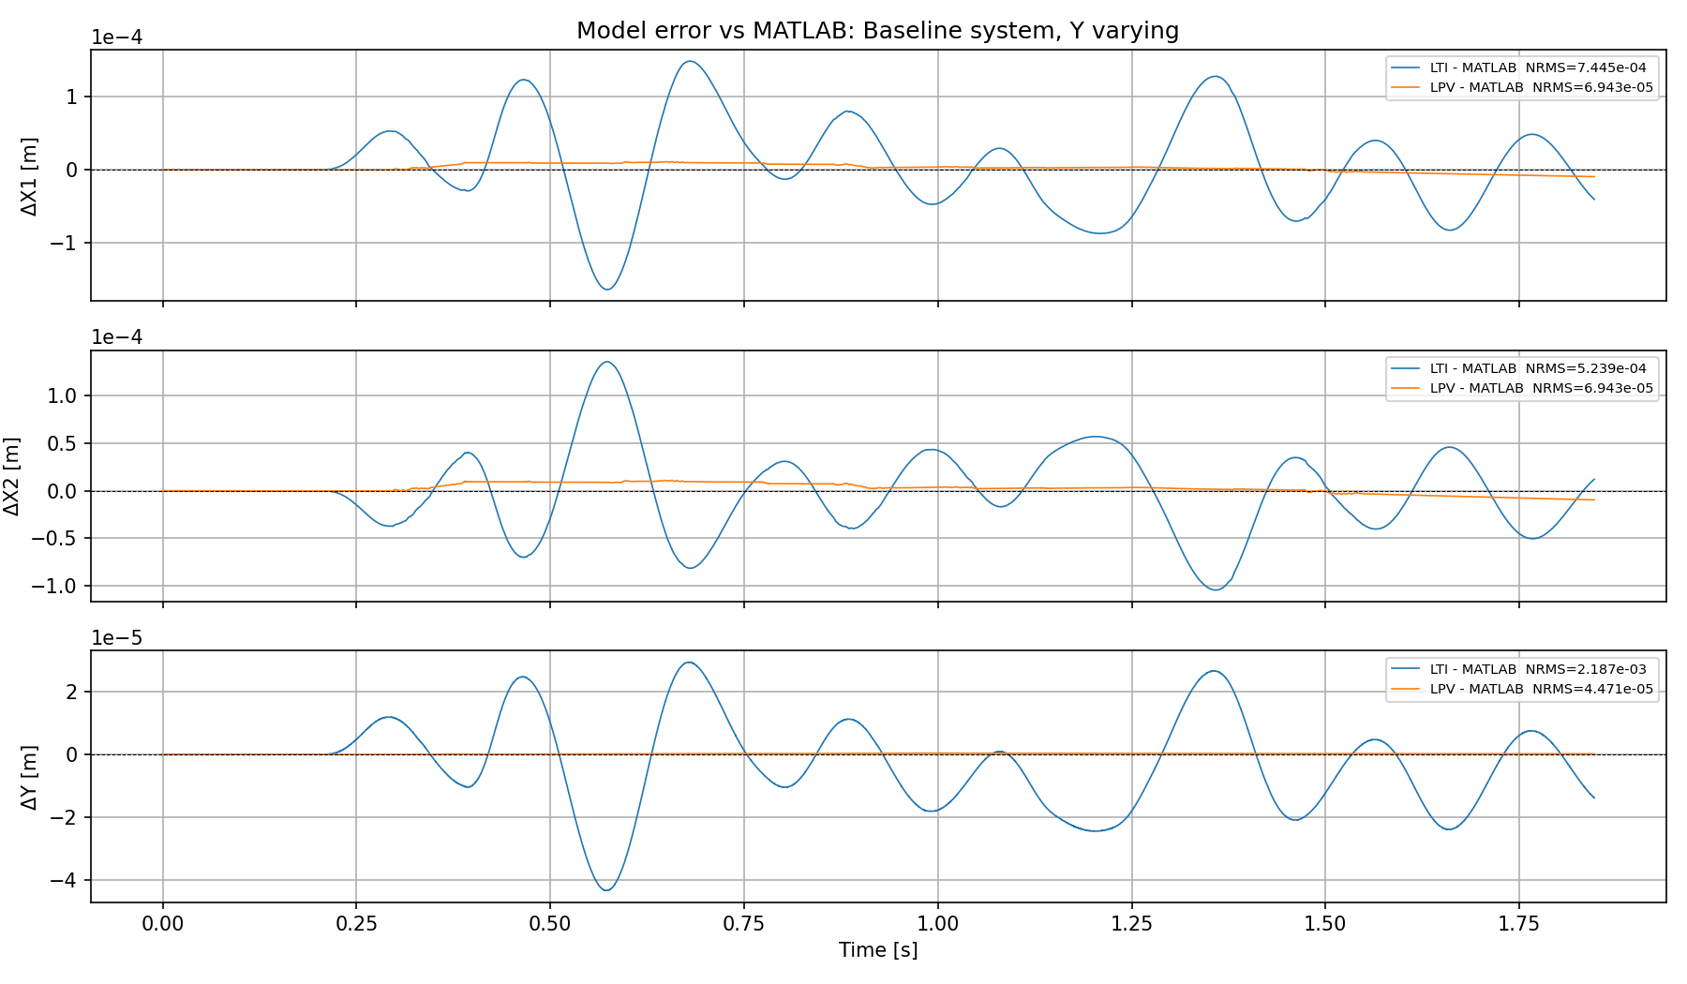

Slide 22
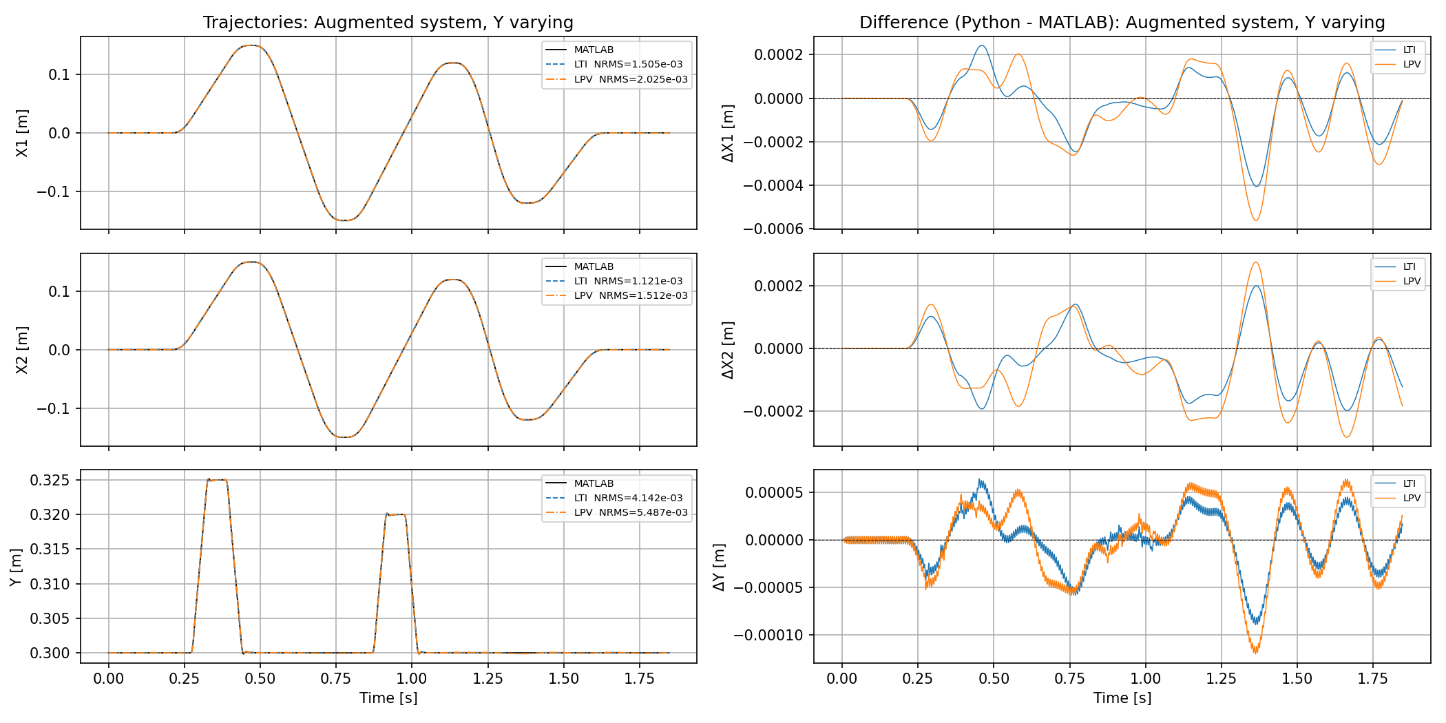
Notes:
1. State normalization — z-score with mean subtraction
x_norm = (x_phys - x_mean) / std_x
2. Input normalization — scaling only, no mean subtraction
u_norm = u / std_u
3. State derivative normalization (inside Gantry_State_Block)
xdot_norm = xdot_phys / std_x

Slide 23
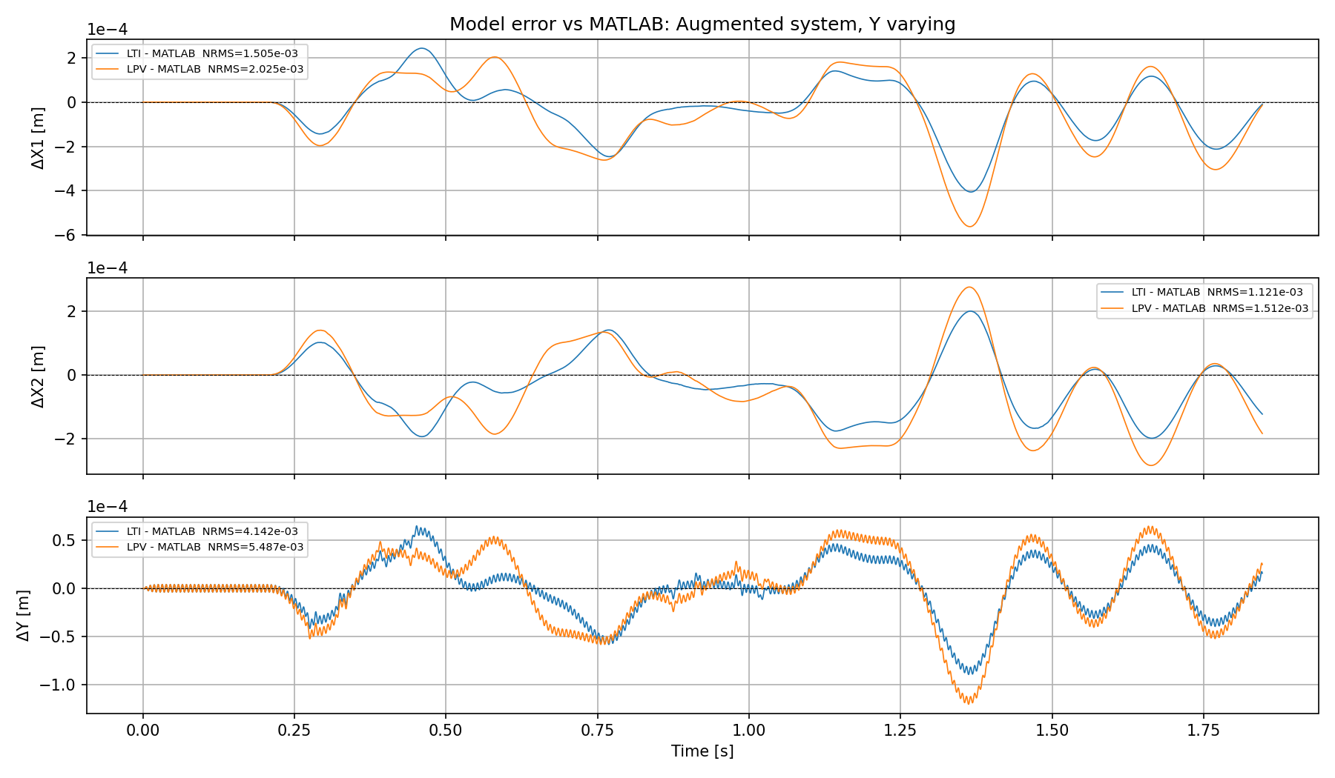

Slide 24
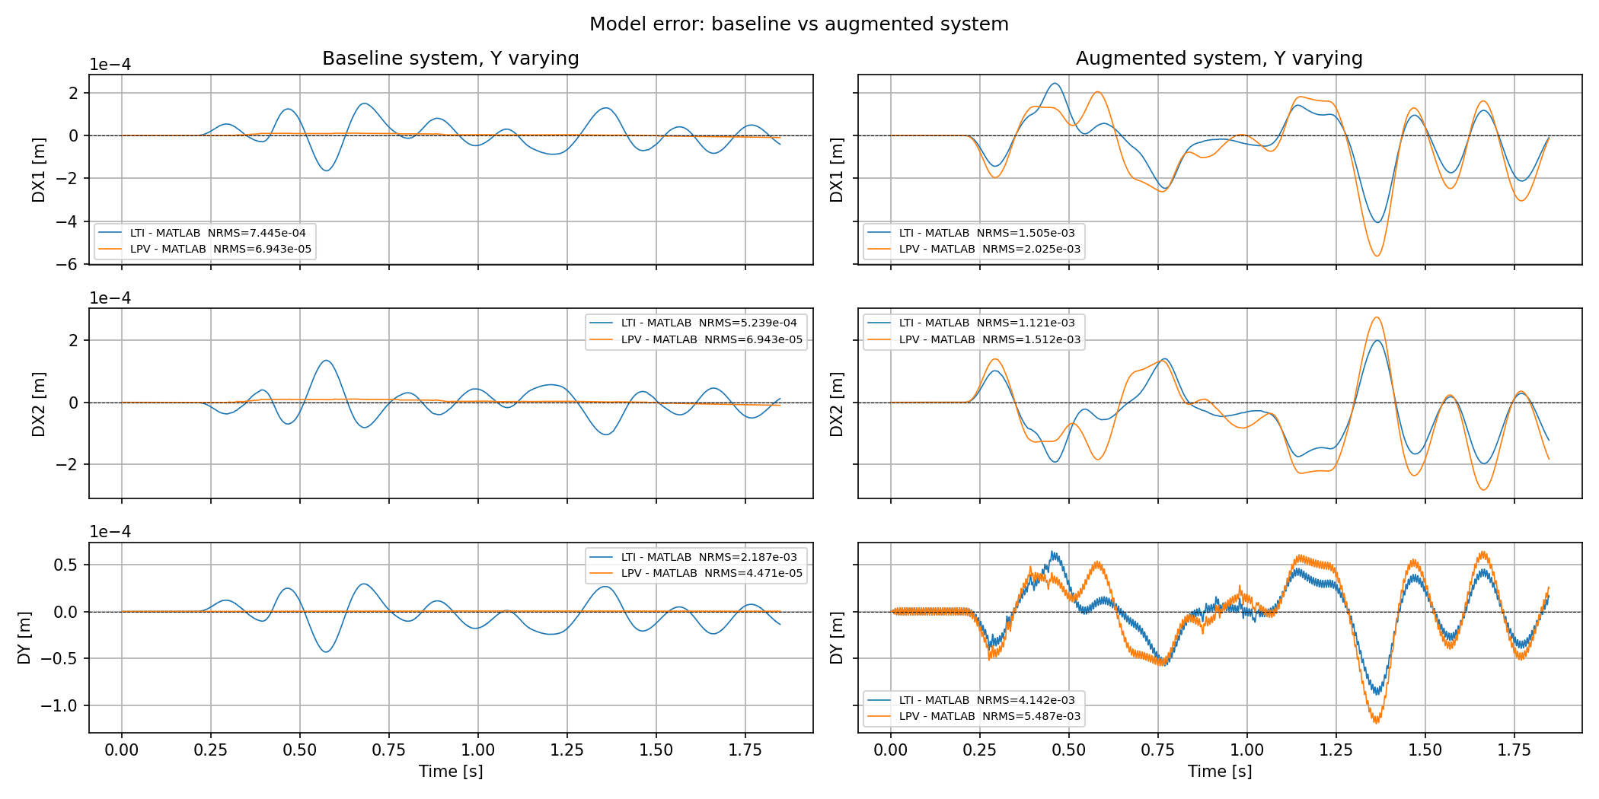
Notes:
1. State normalization — z-score with mean subtraction
x_norm = (x_phys - x_mean) / std_x
2. Input normalization — scaling only, no mean subtraction
u_norm = u / std_u
3. State derivative normalization (inside Gantry_State_Block)
xdot_norm = xdot_phys / std_x

Slide 25
Augmentation
Verify without encoder blocks match the data
Encoder verify. Why?
Dynamic Parallel:
Trajectories
Not LPV one Y-operating point
Should I first do LPV before augmentation, because: I need excitation in the Y-direction and operating point in Y=0.3 (arbitrary) small movements around Y=0.3, but is this enough excitation to observe the MSD dynamics.

Slide 26
Can I do augmentation before LPV?
Look at difference between LTI (one Y-operating point for our model) compared to LPV

Slide 27
The practical question
How much does M_op change over ±25 mm from Y_op = 0.3?
The cross-term in M_op is (m1-m2)*Lb/2 - mh*Y_op. With mh = 10.1
and a 25 mm Y shift:
- Change in that term: 10.1 * 0.025 ≈ 0.25 kg·m
- Relative to the diagonal term (≈ 54 kg): < 0.5%
So ±25 mm gives negligible LTI model error. The LTI assumption
holds well even for the larger Y moves.

Slide 28
Data ASMPT
Unclear when gantry system (Kamtin) will arrive
Would look if we can train on the system from a distance
  If possible only standard set points
Instead will use data from Quinten from telica
  Feedforward improvement
Can include this in my planning to use that data instead for now

Slide 29
Outline next week
Dynamic parallel for gantry setup
Start LPV

Slide 30
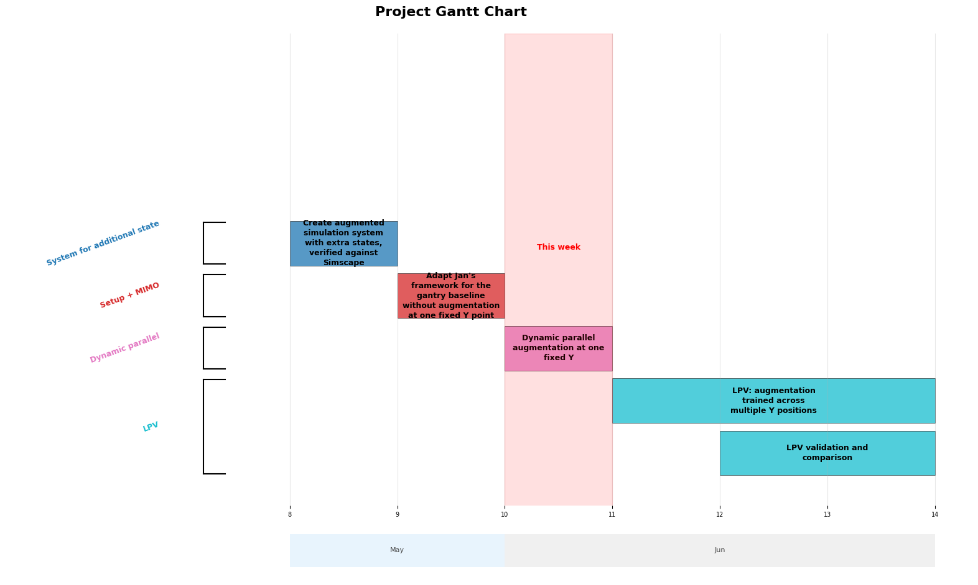

Slide 31
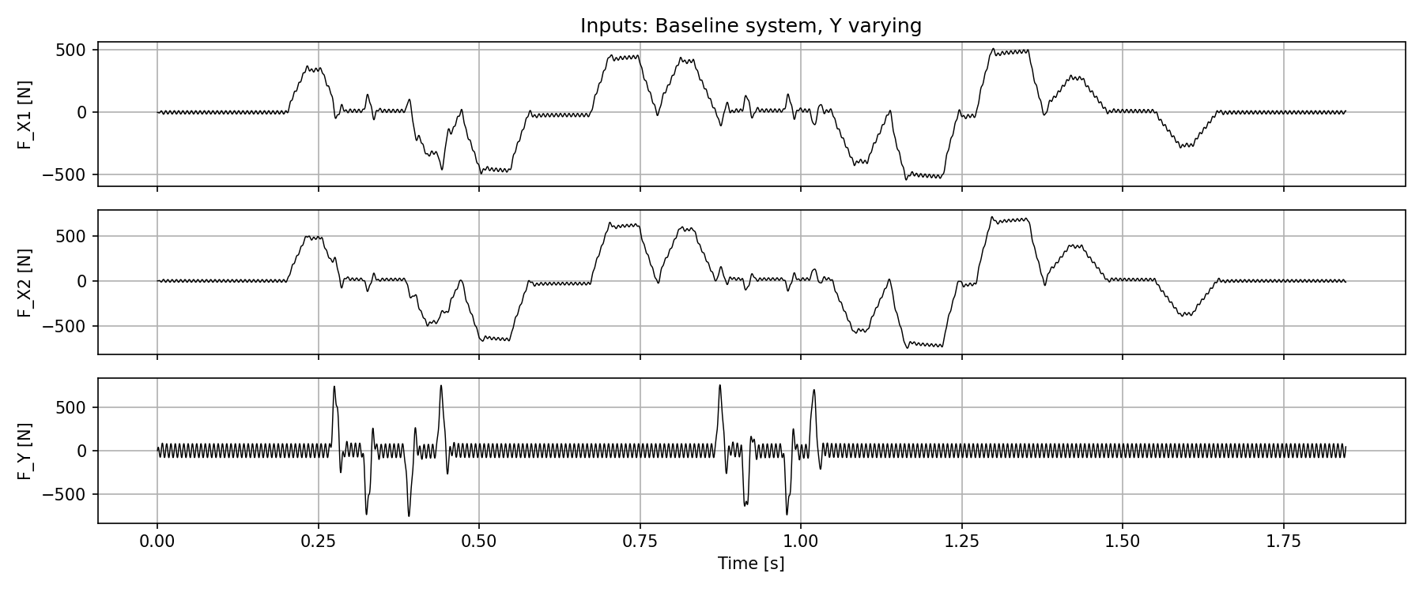

Slide 32
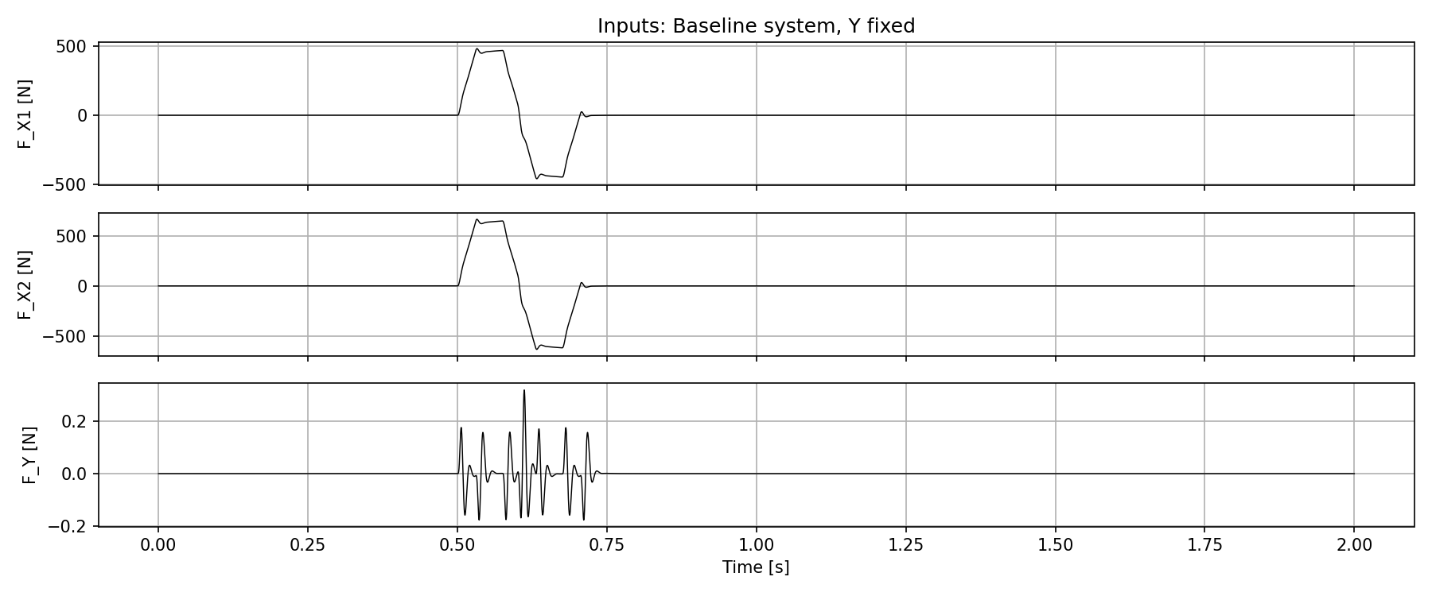

Slide 33
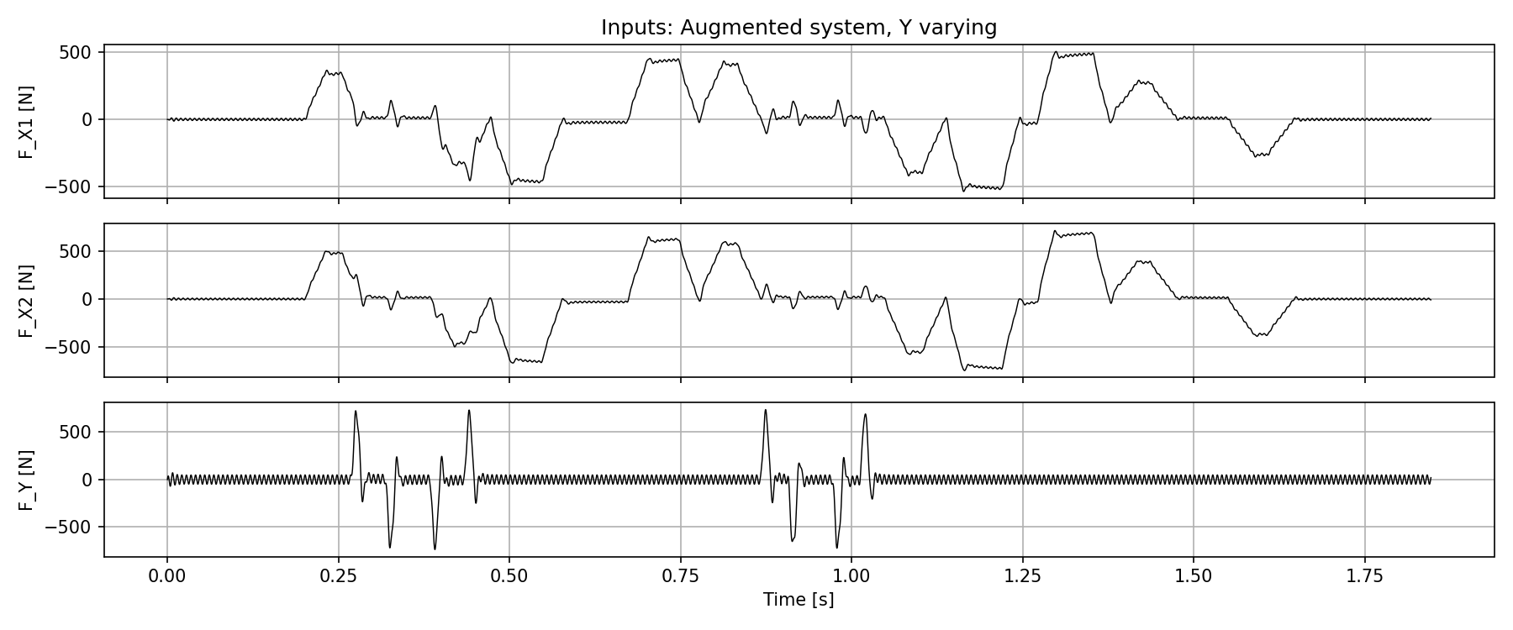

Slide 34
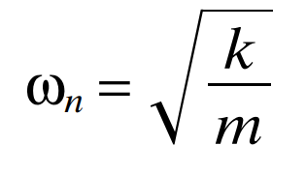
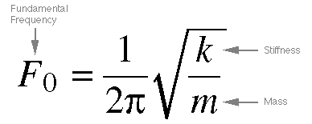
Frequency
400 hz range kijken met massa en spring stiffness → meer realistisch dan in de 27 hz range als ik die nog niet gevonden zou hebben.
Formule jasper gebruiken voor damping coefficient bepalen: Meestal percentage
Offset middelpunt zelfde maken als formules (R)
ka = 1.01 * (2π * 400)² ≈ 6.38 × 10⁶ N/m

Slide 35
Choices:
- Target frequency: f_a = 400 Hz
- Damping ratio: zeta = 0.05 (metal structures with joints, range 0.03-0.07)
Calculated:
k_a = m_a * (2pif_a)^2 = 1.01 * (2pi400)^2 ≈ 6.38e6 N/m
c_a = 2 * zeta * sqrt(k_a * m_a) = 2 * 0.05 * sqrt(6.38e6 * 1.01) ≈ 254 Ns/m

Slide 36
Determining stiffness and damping coefficient
https://www.jpe-innovations.com/precision-point/structural-damping-properties-mechanical-systems/
Formula stiffness circa 200-400 hz (choose 400) but coupled system, so will have to see how it affects.
For damping choose Metal structures with joints 0.03 - 0.07

